Slide 1




Kalman-and-Bayesian-Filters-in-Python
One Dimensional Kalman Filter
Mar 19th, 2022 https://github.com/duyongquan/LTSLAM
AibotBeginer 视觉SLAM
quandy2020@126.com

Slide 2
2
Outline
Problem Description
Introduction to Designing a Filter
Beliefs as Gaussian
Example: Extreme Amounts of Noise
Tracking with Gaussian Probabilities
Example: Incorrect Process Variance
Predictions with Gaussians
Example: Bad Initial Estimate
Updates with Gaussians
Example: Large Noise and Bad Initial Estimate
First Kalman Filter
Exercise: Interactive Plots
Code Walkthrough
Exercise - Nonlinear Systems
Kalman Gain
Fixed Gain Filters
Full Description of the Algorithm
FilterPy’s Implementation
Comparison with g-h and discrete Bayes Filters

Slide 3
Problem Description
3
问题描述

Slide 4
4
Problem Description
一维追踪的例子
1
跟踪长走廊上一条狗移动
2
狗的身上传感器，可以提供狗的相当准确的位置
3
传感器有误差

Slide 5
Beliefs as Gaussian
6
高斯密度函数为置信度

Slide 6
7
Beliefs as Gaussian
高斯表达某时刻狗的位置的置信度
图描述了狗位置的不确定性，它代表了一种相当不准确的概率
虽然我们认为狗最有可能在 10 m 处，但从 9 m 到 11 m 左右的任何位置也很有可能。
假设狗静止不动，我们再次查询传感器。 这次它返回 10.2 m。 我们可以使用这些额外的信息来改进我们的估计吗？

Slide 7
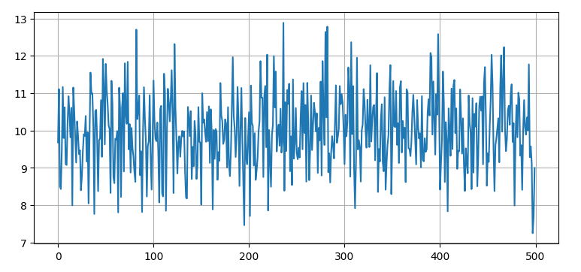
8
Beliefs as Gaussian
传感器噪声
传感器数据读肯定如上图所示
读数的计算平均值几乎正好是 10m（大数定律）

Slide 8
Tracking with Gaussian
Probabilities
9
使用高斯概率追踪

Slide 9
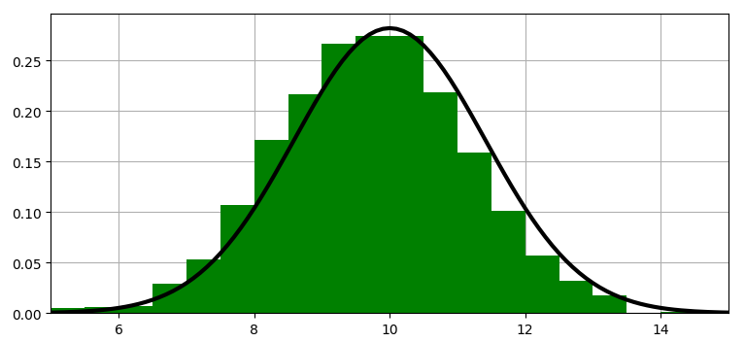
10
Tracking with Gaussian Probabilities
离散贝叶斯滤波器
直方图中的每个 bin 代表一个位置
值是狗处于该位置的概率
直方图替换为高斯图

Slide 10
Predictions with Gaussians
11
使用高斯预测

Slide 11
12
Predictions with Gaussians
牛顿运动方程根据当前速度和先前位置计算当前位置
如果狗在 10 m，他的速度是 15 m/s，epoch 是 2 秒长

Slide 12
13
Predictions with Gaussians
牛顿运动方程根据当前速度和先前位置计算当前位置
如果狗在 10 m，他的速度是 15 m/s，epoch 是 2 秒长

Slide 13
Updates with Gaussians
14
使用高斯更新

Slide 14
15
Updates with Gaussians
牛顿运动方程根据当前速度和先前位置计算当前位置
如果狗在 10 m，他的速度是 15 m/s，epoch 是 2 秒长

Slide 15
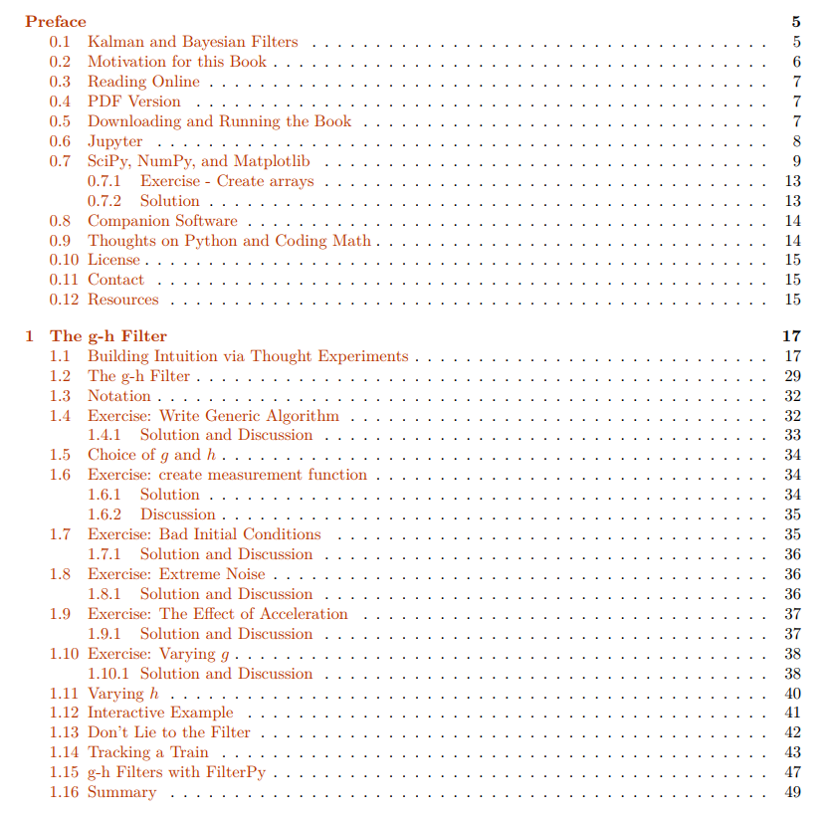
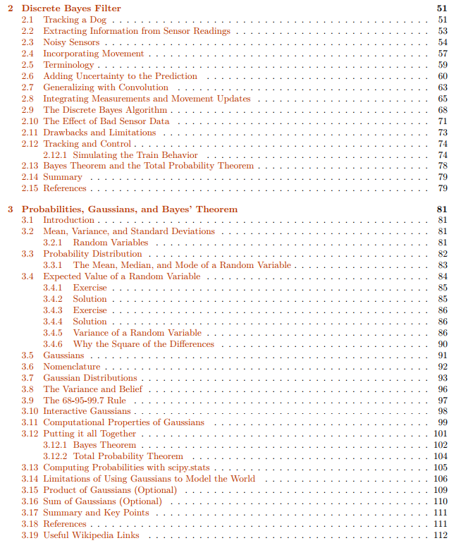
10
PDF Version
PDF book
https://drive.google.com/file/d/0By_SW19c1BfhSVFzNHc0SjduNzg/view?resourcekey=0-41olC9ht9xE3wQe2zHZ45A

Slide 16
Downloading and Running
the Book
11
下载和运行

Slide 17
12
Downloading and Running the Book
Installation
http://nbviewer.ipython.org/github/rlabbe/Kalman-and-Bayesian-Filters-in-Python/blob/master/Appendix-A-Installation.ipynb
Introduce
This book is intended to be interactive and I recommend using it.
Its a little more effort to set up.
You can perform experiments, see how filters react to different data, see how different filters react to the same data, and so on

Slide 18
Jupyter
13
开发环境

Slide 19
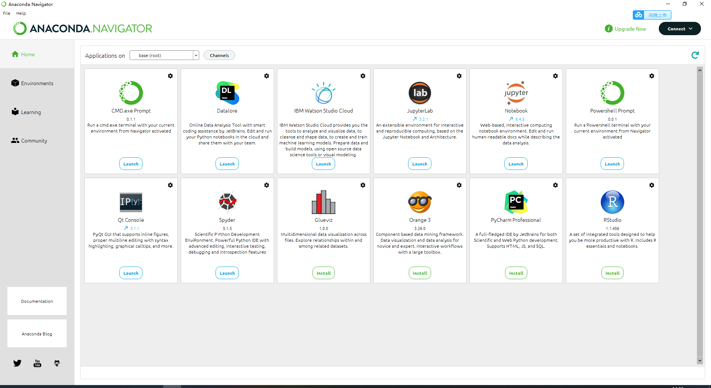
14
Jupyter
jupyter notebook
安装Anaconda

Slide 20
SciPy, NumPy, and Matplotlib
15
Python 库

Slide 21
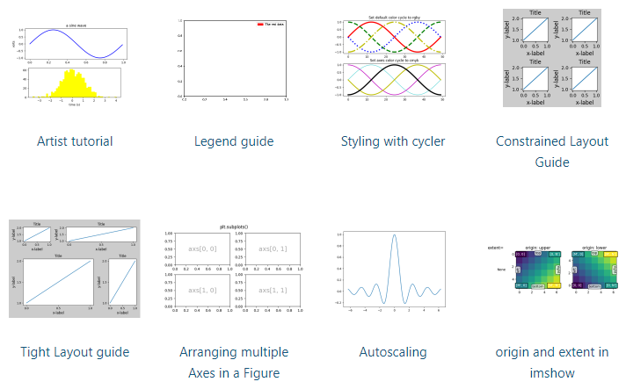
16
SciPy, NumPy, and Matplotlib
SciPy is a mathematic
array objects
https://scipy.org/
linear algebra
random numbers
NumPy
Matplotlib
https://matplotlib.org/stable/tutorials/index

Slide 22
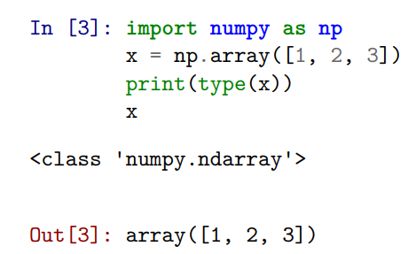
17
SciPy, NumPy, and Matplotlib
numpy.array implements a one or more dimensional array

Slide 23
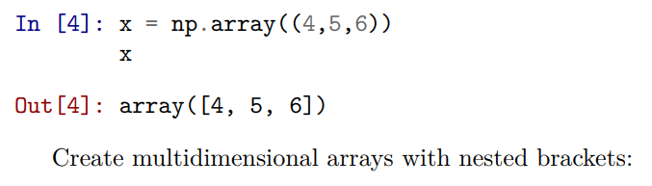
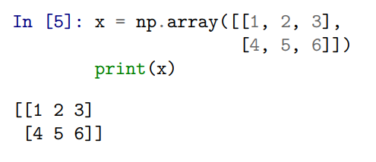
18
SciPy, NumPy, and Matplotlib
numpy.array implements a one or more dimensional array

Slide 24
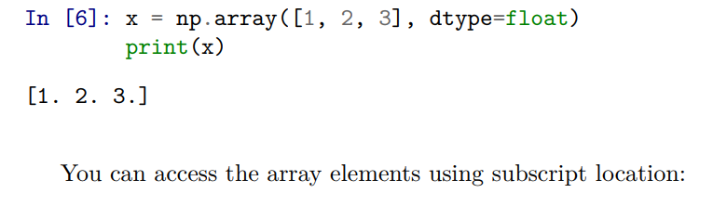
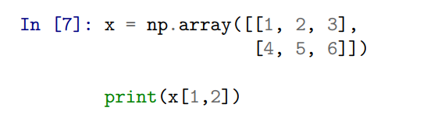
19
SciPy, NumPy, and Matplotlib
numpy.array implements a one or more dimensional array

Slide 25
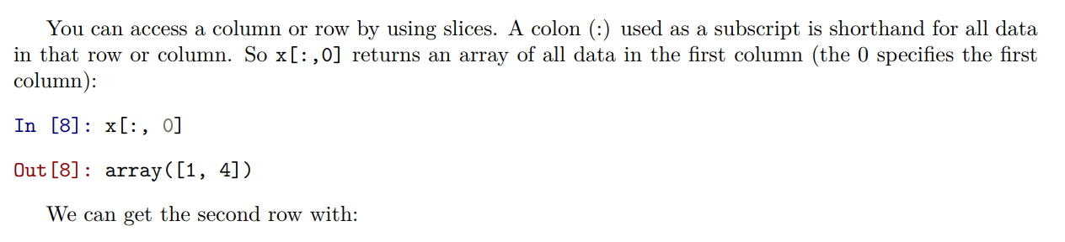
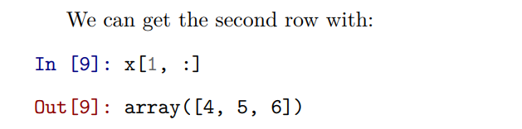
20
SciPy, NumPy, and Matplotlib
numpy.array implements a one or more dimensional array

Slide 26
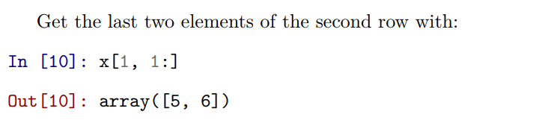
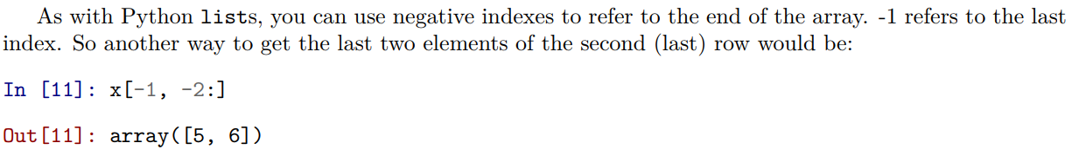
21
SciPy, NumPy, and Matplotlib

Slide 27
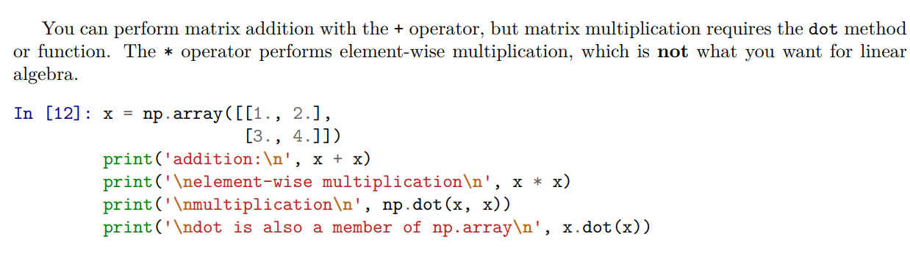
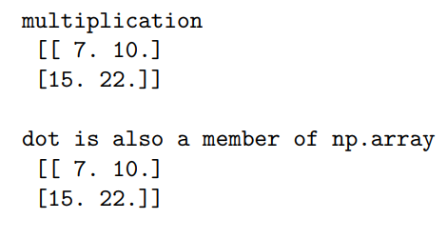
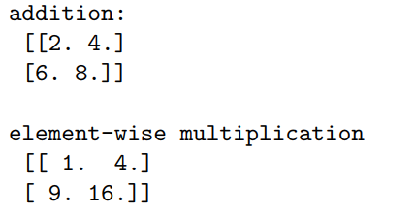
22
SciPy, NumPy, and Matplotlib

Slide 28
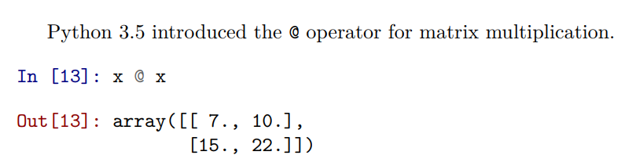
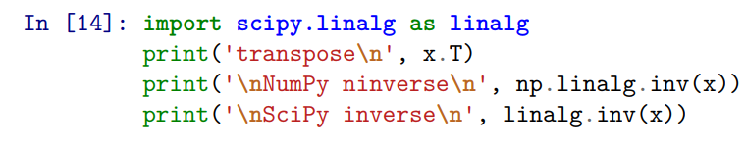
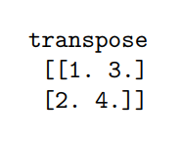
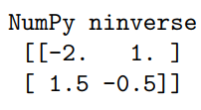
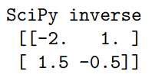
23
SciPy, NumPy, and Matplotlib
transpose and the inverse

Slide 29
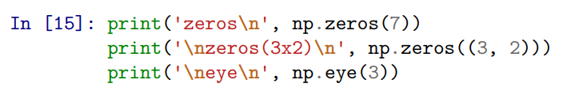
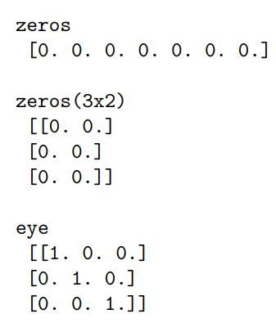
24
SciPy, NumPy, and Matplotlib
zeros matrix , ones matrix, eye identity matrix

Slide 30
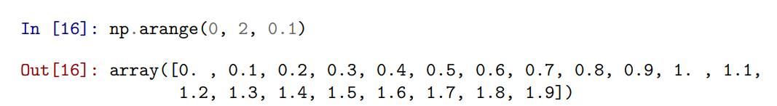
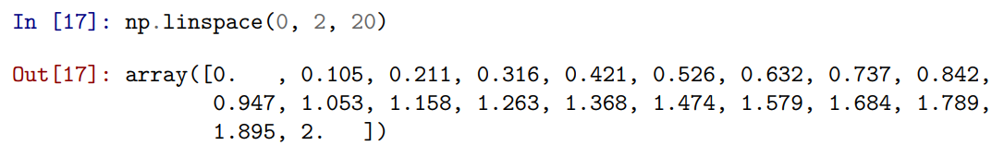
25
SciPy, NumPy, and Matplotlib

Slide 31
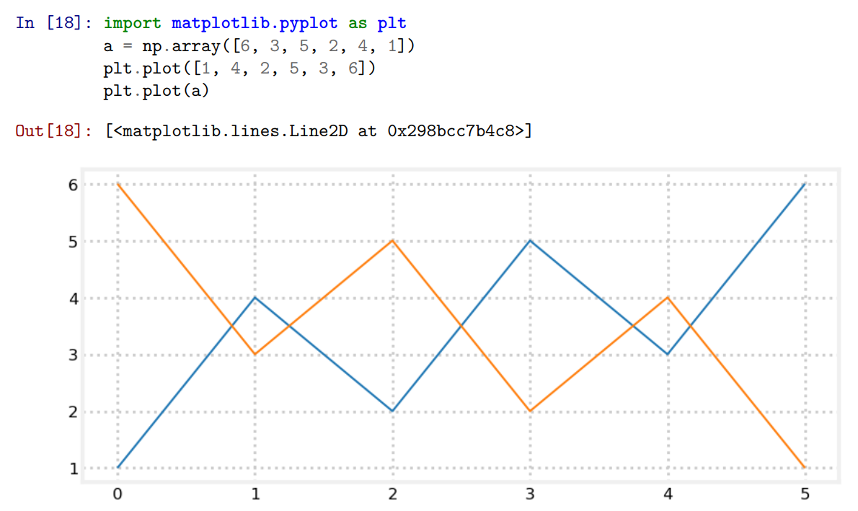
26
SciPy, NumPy, and Matplotlib

Slide 32


